Slide 1
Mutual Fund Analytics Platform
Bluestock Fintech Capstone Project
Sania Gupta

Slide 2
Problem & Objective
Analyze mutual funds, investor behavior, risk metrics, and build interactive dashboards.

Slide 3
Data Sources
10 datasets including NAV history, AUM, SIP inflows, investor transactions, holdings, and benchmarks.

Slide 4
Project Architecture
Data Collection → ETL → EDA → Analytics → Dashboard → Insights

Slide 5
EDA Highlights
Industry AUM growth and AMC analysis

Slide 6
EDA Highlights
SIP inflows and investor growth

Slide 7
Performance Analytics
CAGR, Sharpe Ratio, Sortino Ratio, Alpha, Beta, Drawdown

Slide 8
Advanced Analytics
VaR, CVaR, Rolling Sharpe, HHI, Recommender

Slide 9
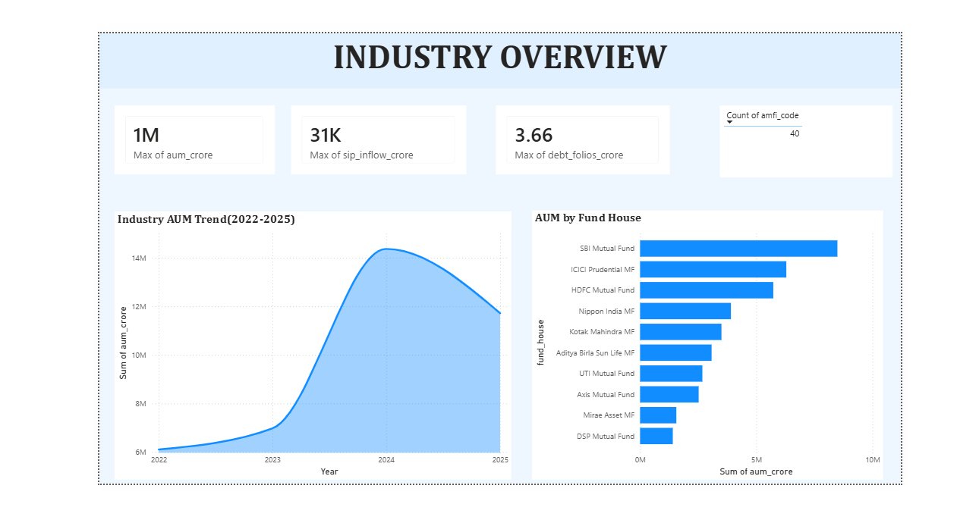
Dashboard - Industry Overview

Slide 10
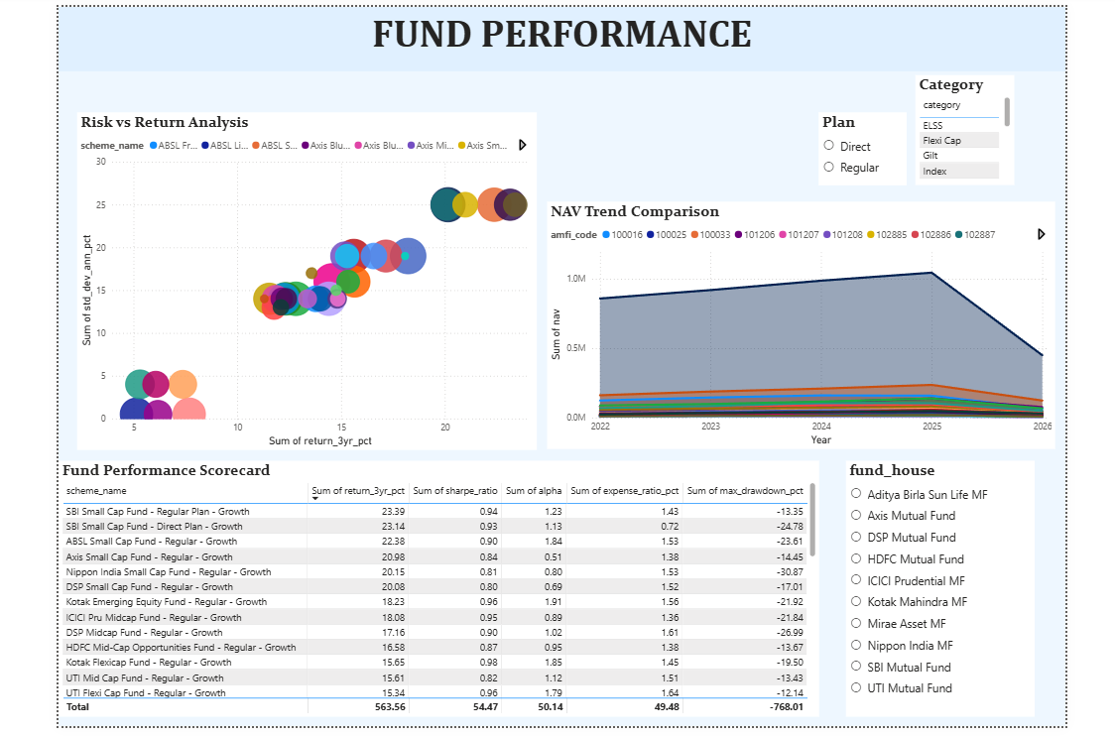
Dashboard - Fund Performance

Slide 11
Key Findings
Major insights from the analysis

Slide 12
Thank You
Any Questions?

